Slide 1
Chapter 10
Image Segmentation

Slide 2
Chapter 10
Image Segmentation
Image segmentation divides an image into regions that are connected and have some similarity within the region and some difference between adjacent regions.
The goal is usually to find individual objects in an image.
For the most part there are fundamentally two kinds of approaches to segmentation: discontinuity and similarity.
Similarity may be due to pixel intensity, color or texture.
Differences are sudden changes (discontinuities) in any of these, but especially sudden changes in intensity along a boundary line, which is called an edge.

Slide 3
Image Segmentation
Discontinuity
Similarity
e.g.
- Point Detection
- Line Detection
- Edge Detection
e.g.
- Thresholding
- Region Growing
- Region splitting &
merging

Slide 4
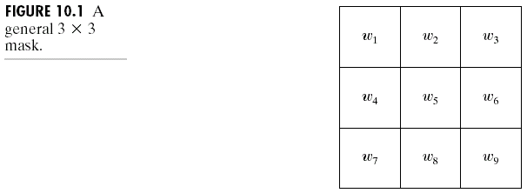
Detection of Discontinuities
There are three kinds of discontinuities of intensity: points, lines and edges.
The most common way to look for discontinuities is to scan a small mask over the image. The mask determines which kind of discontinuity to look for.

Slide 5
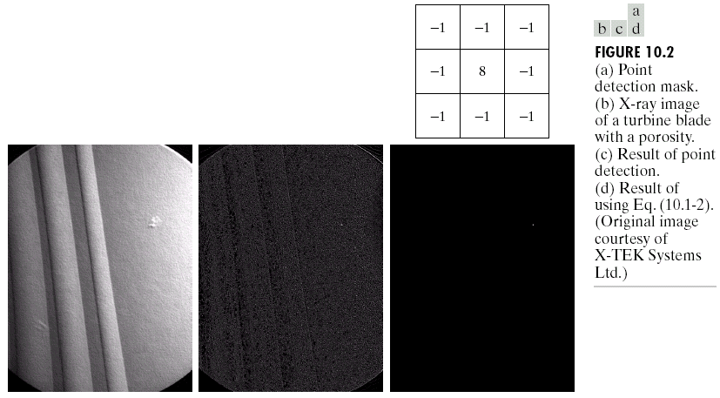
Detection of Discontinuities
Point Detection

Slide 6
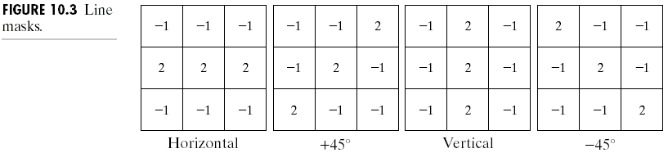
Detection of Discontinuities
Line Detection
Only slightly more common than point detection is to find a one pixel wide line in an image.
For digital images the only three point straight lines are only horizontal, vertical, or diagonal (+ or –45°).

Slide 7
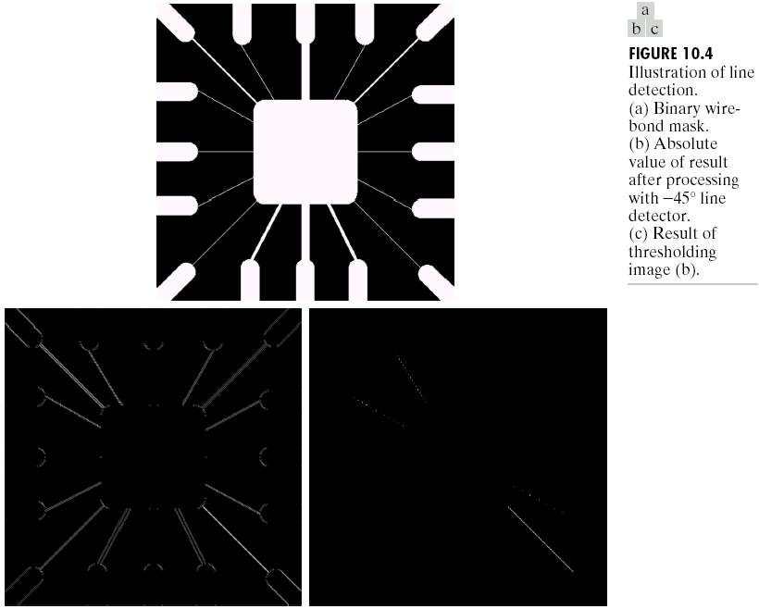
Detection of Discontinuities
Line Detection

Slide 8
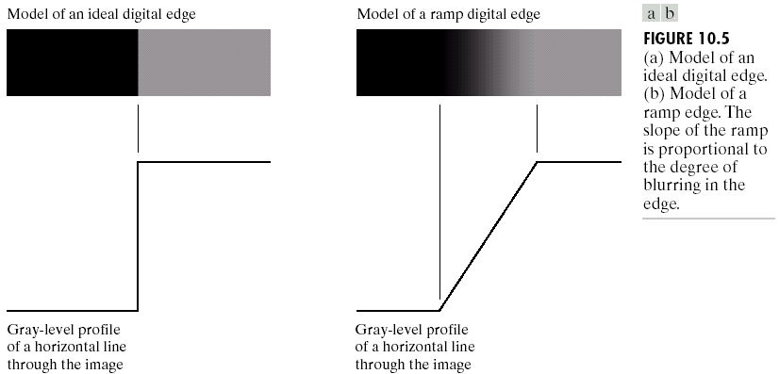
Detection of Discontinuities
Edge Detection

Slide 9
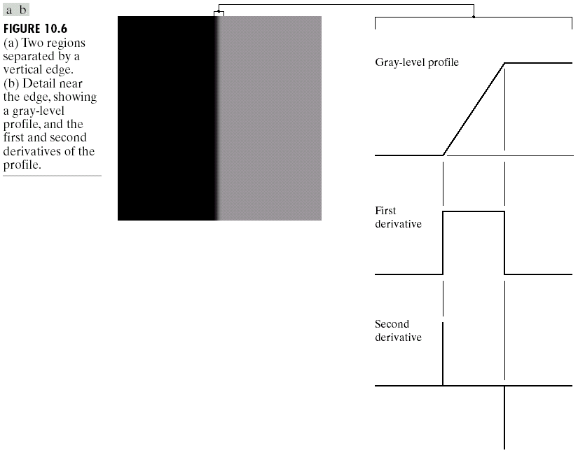
Detection of Discontinuities
Edge Detection

Slide 10

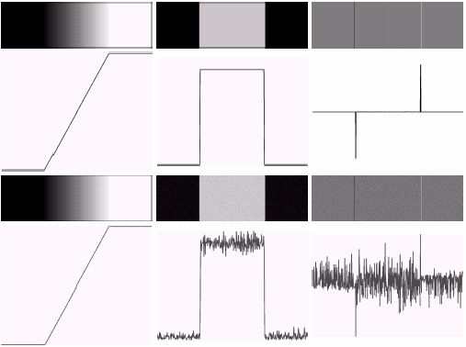
Detection of Discontinuities
Edge Detection

Slide 11
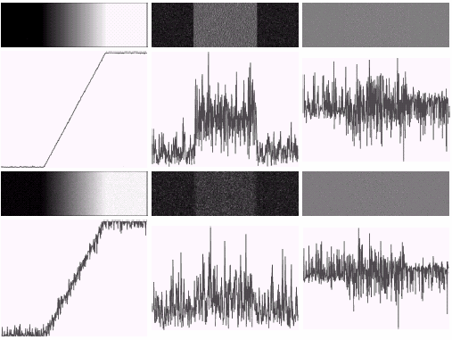
Detection of Discontinuities
Edge Detection

Slide 12
Detection of Discontinuities
Gradient Operators
First-order derivatives:
The gradient of an image f(x,y) at location (x,y) is defined as the vector:
The magnitude of this vector:
The direction of this vector:

Slide 13
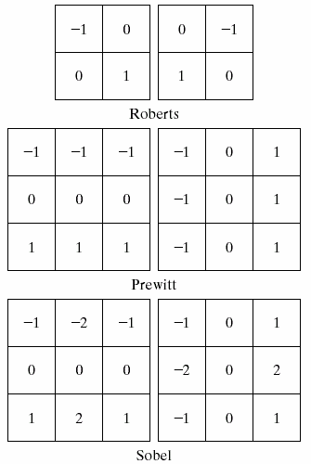
Detection of Discontinuities
Gradient Operators
Roberts cross-gradient operators
Prewitt operators
Sobel operators

Slide 14
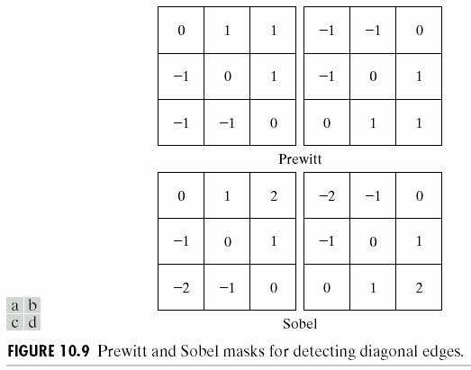
Detection of Discontinuities
Gradient Operators
Prewitt masks for
detecting diagonal edges
Sobel masks for
detecting diagonal edges

Slide 15
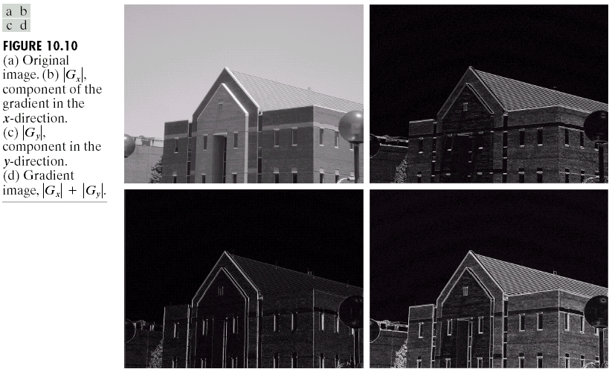
Detection of Discontinuities
Gradient Operators: Example

Slide 16
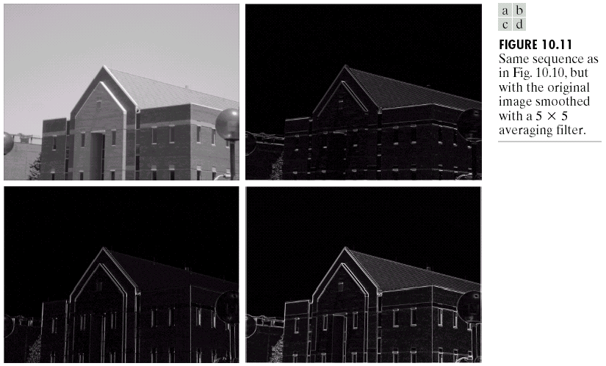
Detection of Discontinuities
Gradient Operators: Example

Slide 17
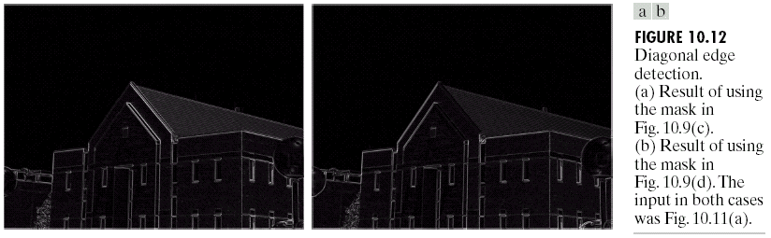
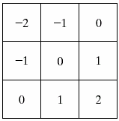
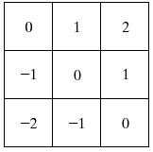
Detection of Discontinuities
Gradient Operators: Example

Slide 18
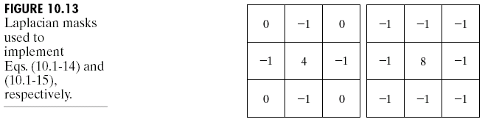
Detection of Discontinuities
Gradient Operators
Second-order derivatives: (The Laplacian)
The Laplacian of an 2D function f(x,y) is defined as
Two forms in practice:

Slide 19
Detection of Discontinuities
Gradient Operators
Consider the function:
The Laplacian of h is
The Laplacian of a Gaussian sometimes is called the Mexican hat function. It also can be computed by smoothing the image with the Gaussian smoothing mask, followed by application of the Laplacian mask.
A Gaussian function
The Laplacian of a Gaussian (LoG)

Slide 20
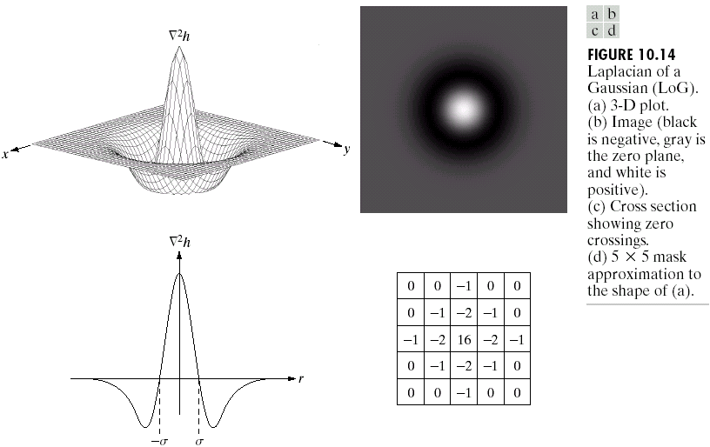
Detection of Discontinuities
Gradient Operators

Slide 21
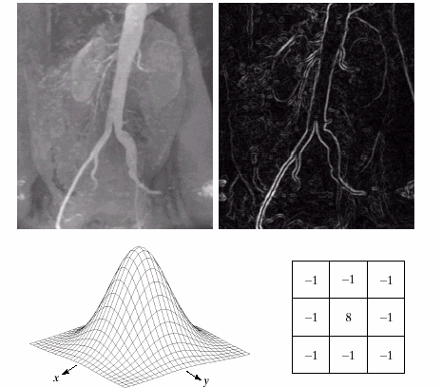
Detection of Discontinuities
Gradient Operators: Example
Sobel gradient
Gaussian smooth function
Laplacian mask

Slide 22
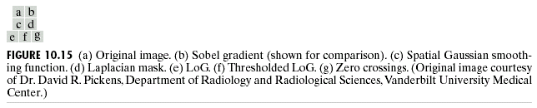
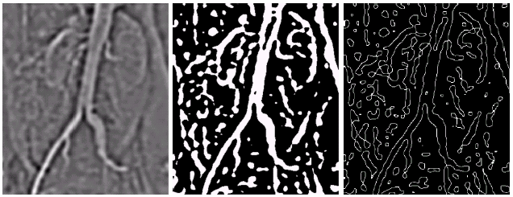
Detection of Discontinuities
Gradient Operators: Example

Slide 23
Edge Linking and Boundary Detection
Local Processing
Two properties of edge points are useful for edge linking:
the strength (or magnitude) of the detected edge points
their directions (determined from gradient directions)
This is usually done in local neighborhoods.
Adjacent edge points with similar magnitude and direction are linked.
For example, an edge pixel with coordinates (x₀,y₀) in a predefined neighborhood of (x,y) is similar to the pixel at (x,y) if

Slide 24
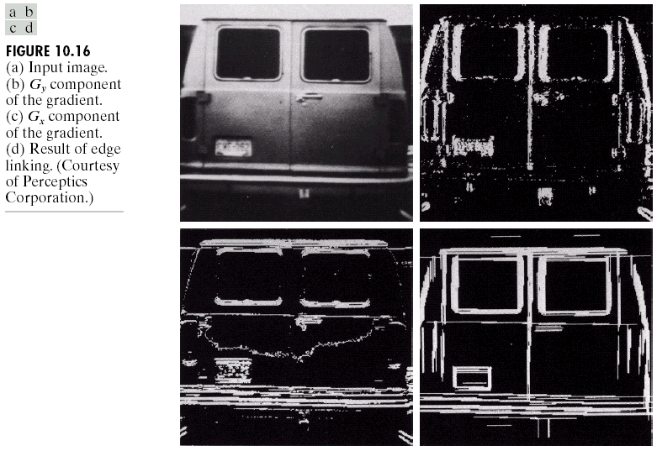
Edge Linking and Boundary Detection
Local Processing: Example
In this example,
we can find the
license plate
candidate after
edge linking
process.

Slide 26

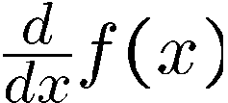
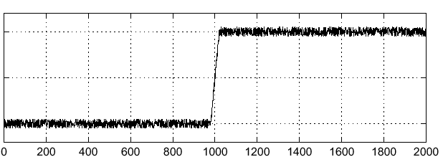
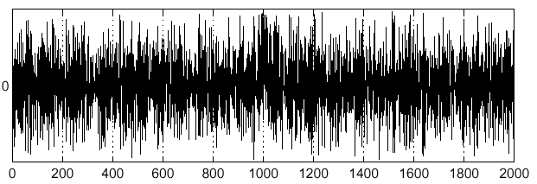
Effects of Noise
Consider a single row or column of the image
Plotting intensity as a function of position gives a signal
Where is the edge??

Slide 27



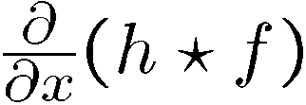
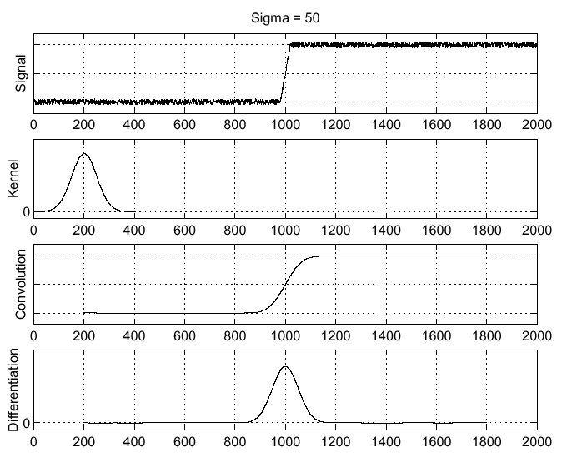
Solution: Smooth First
Where is the edge?
Look for peaks in

Slide 28
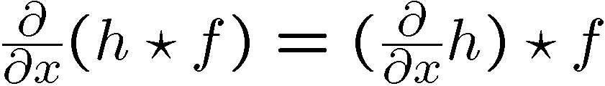
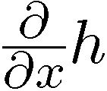
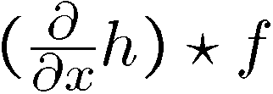
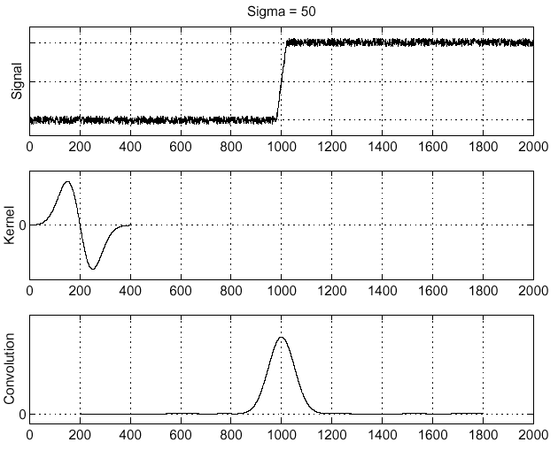
Derivative Theorem of Convolution
…saves us one operation.

Slide 29
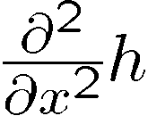
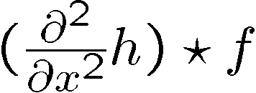
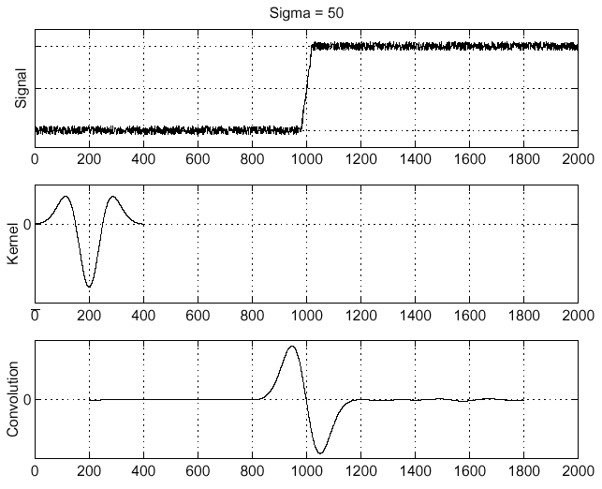
Laplacian of Gaussian (LoG)
Laplacian of Gaussian
Laplacian of Gaussian operator
Where is the edge?
Zero-crossings of bottom graph !

Slide 30
Canny Edge Operator
Smooth image I with 2D Gaussian:
Find local edge normal directions for each pixel
Compute edge magnitudes
Locate edges by finding zero-crossings along the edge normal directions (non-maximum suppression)

Slide 31

Non-maximum Suppression
Check if pixel is local maximum along gradient direction
requires checking interpolated pixels p and r

Slide 32
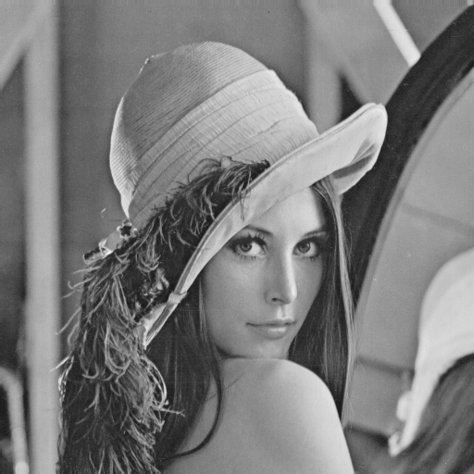
The Canny Edge Detector
original image (Lena)

Slide 33
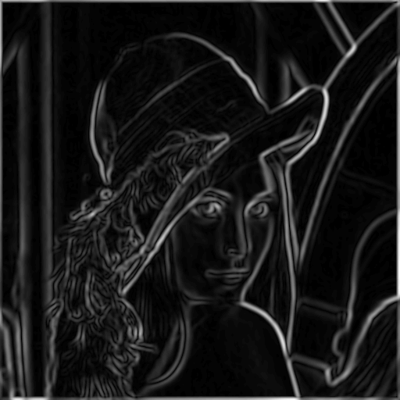
The canny edge detector
magnitude of the gradient

Slide 34
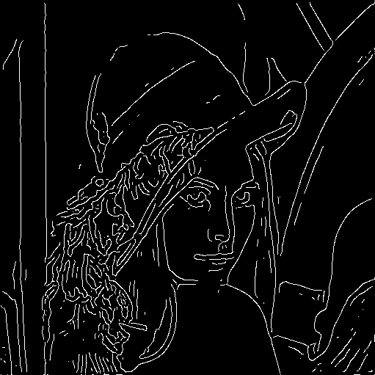
The Canny Edge Detector
After non-maximum suppression

Slide 35

Edge Linking and Boundary Detection
Global Processing via the Hough Transform
Canny Edge Detection Algorithm
An edge detection algorithm detects edges in an image by determining where the brightness/intensity of an image changes drastically.
For the Hough Transform algorithm, it is crucial to perform edge detection first to produce an edge image which will then be used as input into the algorithm.

Slide 36
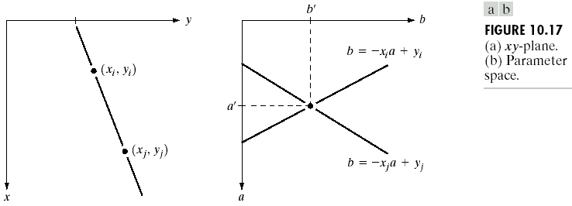
Edge Linking and Boundary Detection
Global Processing via the Hough Transform
Hough transform: a way of finding edge points in an image that lie along a straight line.
Example: xy-plane v.s. ab-plane (parameter space)

Slide 37
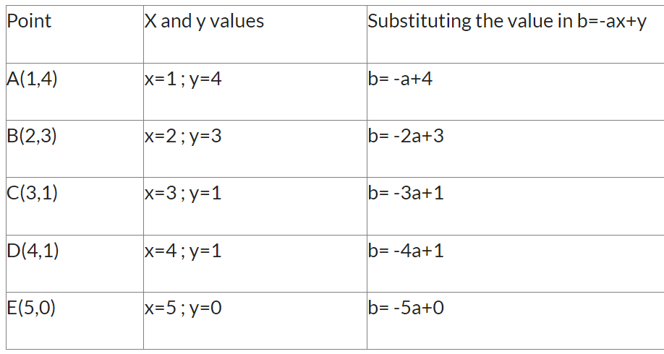
Problem: Given set of points, use Hough transform to join these points. A(1,4), B(2,3) ,C(3,1) ,D(4,1) ,E(5,0)
Solution:
Lets think about equation of line that is y=ax+b.
Now, if we rewrite the same line equation by keeping b in LHS, then we get b=-ax+y. So if we write the same equation for point A(1,4), then consider x=1 and y=4 so that we will get b=-a+4. The following table shows all the equations for a given point

Slide 38
Point | equations | Now a=0 | New point (a,b) | Now a=1 | New point (a,b)
A(1,4) | b= -a+4 | b= -(0)+4 =4 | (0,4) | b= -(1)+4 =3 | (1,3)
B(2,3) | b= -2a+3 | b= -2(0)+3=3 | (0,3) | b= -2(1)+3=1 | (1,1)
C(3,1) | b= -3a+1 | b= -3(0)+1=1 | (0,1) | b= -3(1)+1=-2 | (1,-2)
D(4,1) | b= -4a+1 | b= -4(0)+1=1 | (0,1) | b= -4(1)+1=3 | (1,-3)
E(5,0) | b= -5a+0 | b= -5(0)+0=0 | (0,0) | b= -5(1)+0=-5 | (1,-5)

Slide 39
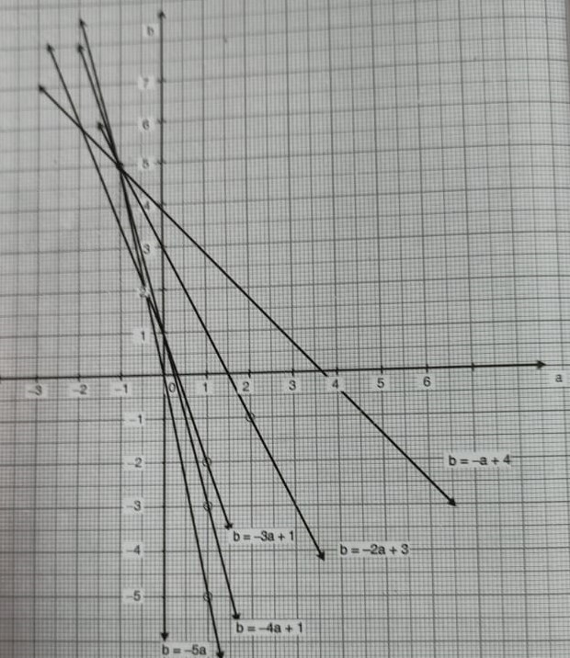
Let us plot the new point on the graph as given below
Point | New point (a,b) | New point (a,b)
A(1,4) | (0,4) | (1,3)
B(2,3) | (0,3) | (1,1)
C(3,1) | (0,1) | (1,-2)
D(4,1) | (0,1) | (1,-3)
E(5,0) | (0,0) | (1,-5)

Slide 40
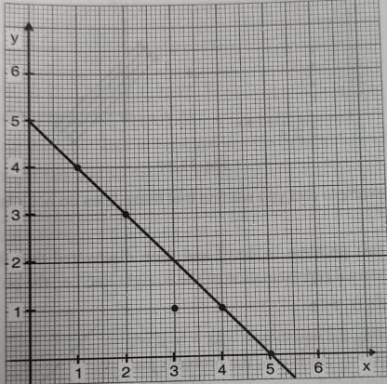
We can see that almost all line cross each other at a point (-1,5). So here now a=-1 and b =5.
Now let’s put these values in the y=ax+b equation so we get y=-1x+5 so y=-x+5 is the line equation that will link all the edges.

Slide 41
Edge Linking and Boundary Detection
Global Processing via the Hough Transform
There is one flaw with representing lines in the form of y = ax + b and the Hough Space with the slope and intercept.
In this form, the algorithm won’t be able to detect vertical lines because the slope a is undefined/infinity for vertical lines (Leavers, 1992).
Programmatically, this means that a computer would need an infinite amount of memory to represent all possible values of a.
To avoid this issue, a straight line is instead represented by a line called the normal line that passes through the origin and perpendicular to that straight line. The form of the normal line is ρ = x cos(θ) + y sin(θ) where ρ is the length of the normal line and θ is the angle between the normal line and the x axis.

Slide 42
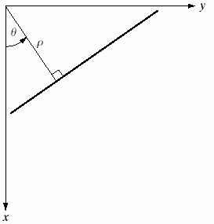
Edge Linking and Boundary Detection
Global Processing via the Hough Transform
The Hough transform consists of finding all pairs of values of θ and ρ which satisfy the equations that pass through (x,y).
These are accumulated in what is basically a 2-dimensional histogram.
When plotted these pairs of θ and ρ will look like a sine wave. The process is repeated for all appropriate (x,y) locations.
https://sbme-tutorials.github.io/2021/cv/notes/4_week4.html

Slide 43
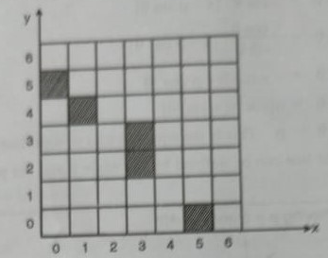
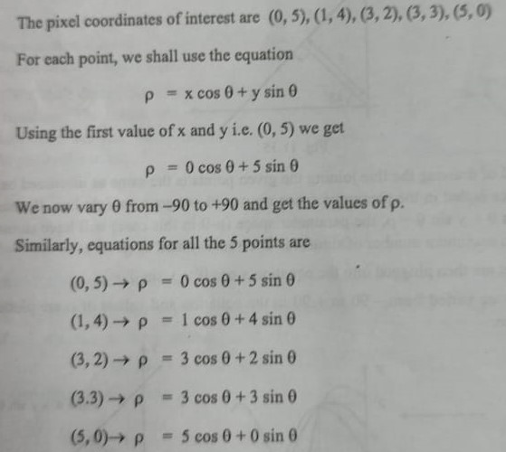
For the given image use Hough Transform to form the edge.
Solution:

Slide 44
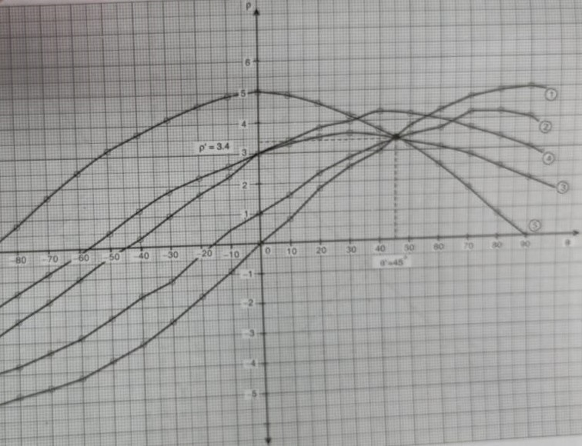

Slide 45
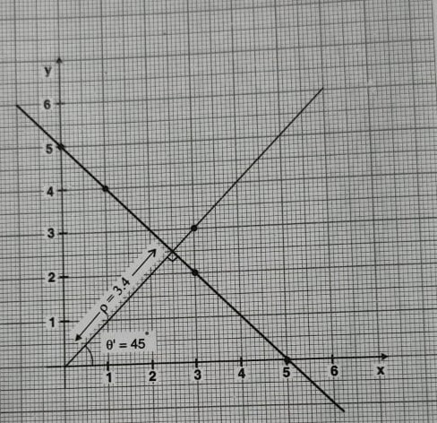
As can be seen, the line passes through 4 points, point(3,3) is kept outside as it does not lie on the line

Slide 46
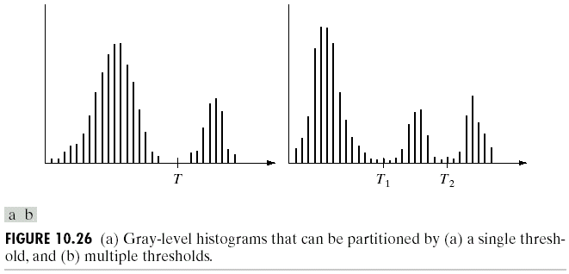
Thresholding
Assumption: the range of intensity levels covered by objects of interest is different from the background.
Single threshold
Multiple threshold

Slide 47
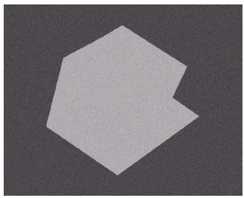
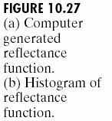
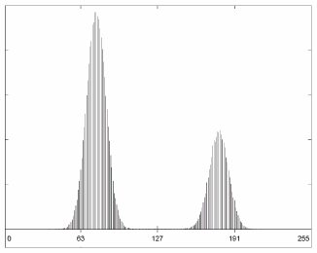
Thresholding
The Role of Illumination

Slide 48
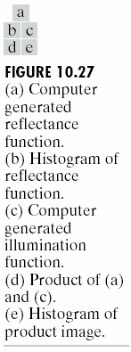


Thresholding
The Role of Illumination
(a)
(c)
(d)
(e)

Slide 49

Thresholding
Basic Global Thresholding

Slide 50

Thresholding
Basic Global Thresholding

Slide 51

Thresholding
Basic Adaptive Thresholding

Slide 52



Thresholding
Basic Adaptive Thresholding
How to solve this problem?

Slide 53


Thresholding
Basic Adaptive Thresholding
Answer: subdivision

Slide 54

Thresholding
Optimal Global and Adaptive Thresholding
This method treats pixel values as probability density functions.
The goal of this method is to minimize the probability of misclassifying pixels as either object or background.
There are two kinds of error:
mislabeling an object pixel as background, and
mislabeling a background pixel as object.

Slide 55

Thresholding
Use of Boundary Characteristics

Slide 56

Thresholding
Thresholds Based on Several Variables
Color image

Slide 57
Region-Based Segmentation
Edges and thresholds sometimes do not give good results for segmentation.
Region-based segmentation is based on the connectivity of similar pixels in a region.
Each region must be uniform.
Connectivity of the pixels within the region is very important.
There are two main approaches to region-based segmentation: region growing and region splitting.

Slide 58



Slide 59


Slide 60
Region-Based Segmentation
Basic Formulation
Let R represent the entire image region.
Segmentation is a process that partitions R into subregions, R₁,R₂,…,R_{n}, such that
where P(R_{k}): a logical predicate defined over the points in set R_{k}
For example: P(R_{k})=TRUE if all pixels in R_{k} have the same gray level.

Slide 61
Region Growing
Region growing is a procedure that groups pixels or subregions into larger regions.
The simplest of these approaches is pixel aggregation, which starts with a set of “seed” points and from these grows regions by appending to each seed points those neighboring pixels that have similar properties (such as gray level, texture, color, shape).
Region growing based techniques are better than the edge-based techniques in noisy images where edges are difficult to detect.

Slide 62

Region Growing
Threshold=10
10 | 10 | 10 | 10 | 10 | 10 | 10
10 | 10 | 10 | 69 | 70 | 10 | 10
59 | 10 | 60 | 64 | 59 | 56 | 60
10 | 59 | 10 | 60 | 70 | 10 | 62
10 | 60 | 59 | 65 | 67 | 10 | 65
10 | 10 | 10 | 10 | 10 | 10 | 10
10 | 10 | 10 | 10 | 10 | 10 | 10

Slide 63
10 | 10 | 10 | 10 | 10 | 10 | 10
10 | 10 | 10 | 69 | 70 | 10 | 10
59 | 10 | 60 | 64 | 59 | 56 | 60
10 | 59 | 10 | 60 | 70 | 10 | 62
10 | 60 | 59 | 65 | 67 | 10 | 65
10 | 10 | 10 | 10 | 10 | 10 | 10
10 | 10 | 10 | 10 | 10 | 10 | 10
10 | 10 | 10 | 10 | 10 | 10 | 10
10 | 10 | 10 | 69 | 70 | 10 | 10
59 | 10 | 60 | 64 | 59 | 56 | 60
10 | 59 | 10 | 60 | 70 | 10 | 62
10 | 60 | 59 | 65 | 67 | 10 | 65
10 | 10 | 10 | 10 | 10 | 10 | 10
10 | 10 | 10 | 10 | 10 | 10 | 10
10 | 10 | 10 | 10 | 10 | 10 | 10
10 | 10 | 10 | 69 | 70 | 10 | 10
59 | 10 | 60 | 64 | 59 | 56 | 60
10 | 59 | 10 | 60 | 70 | 10 | 62
10 | 60 | 59 | 65 | 67 | 10 | 65
10 | 10 | 10 | 10 | 10 | 10 | 10
10 | 10 | 10 | 10 | 10 | 10 | 10
10 | 10 | 10 | 10 | 10 | 10 | 10
10 | 10 | 10 | 69 | 70 | 10 | 10
59 | 10 | 60 | 64 | 59 | 56 | 60
10 | 59 | 10 | 60 | 70 | 10 | 62
10 | 60 | 59 | 65 | 67 | 10 | 65
10 | 10 | 10 | 10 | 10 | 10 | 10
10 | 10 | 10 | 10 | 10 | 10 | 10
10 | 10 | 10 | 10 | 10 | 10 | 10
10 | 10 | 10 | 69 | 70 | 10 | 10
59 | 10 | 60 | 64 | 59 | 56 | 60
10 | 59 | 10 | 60 | 70 | 10 | 62
10 | 60 | 59 | 65 | 67 | 10 | 65
10 | 10 | 10 | 10 | 10 | 10 | 10
10 | 10 | 10 | 10 | 10 | 10 | 10
10 | 10 | 10 | 10 | 10 | 10 | 10
10 | 10 | 10 | 69 | 70 | 10 | 10
59 | 10 | 60 | 64 | 59 | 56 | 60
10 | 59 | 10 | 60 | 70 | 10 | 62
10 | 60 | 59 | 65 | 67 | 10 | 65
10 | 10 | 10 | 10 | 10 | 10 | 10
10 | 10 | 10 | 10 | 10 | 10 | 10

Slide 64


Region-Based Segmentation
Region Growing
Fig. 10.41 shows the histogram of Fig. 10.40 (a). It is difficult to segment the defects by thresholding methods. (Applying region growing methods are better in this case.)
Figure 10.40(a)
Figure 10.41

Slide 65

Region-Based Segmentation
Region Growing

Slide 66
Region-Based Segmentation
Region Splitting and Merging
Region splitting is the opposite of region growing.
First there is a large region (possible the entire image).
Then a predicate (measurement) is used to determine if the region is uniform.
If not, then the method requires that the region be split into two regions.
Then each of these two regions is independently tested by the predicate (measurement).
This procedure continues until all resulting regions are uniform.

Slide 67

Region-Based Segmentation
Region Splitting
The main problem with region splitting is determining where to split a region.
One method to divide a region is to use a quadtree structure.
Quadtree: a tree in which nodes have exactly four descendants.

Slide 68




Threshold<=3

Slide 69


Region merging algorithms
The region merging method is exactly opposite to the region splitting method.
In this method, the pixel level and consider each of them as a homogenous region.
At any level of merging, check if the four adjacent homogenous regions arranged in a 2 x 2 fashion together satisfy the homogeneity property.
If yes, they are merged to form a bigger region, otherwise the regions are left as they are.
max - min ≤ 3

Slide 70
Region-Based Segmentation
Region Splitting and Merging
START: consider entire image as one region
1. If region satisfies homogeneity criteria, leave it unmodified.
2. If not, split it into four quadrants and recursively apply 1 and 2 to each newly generated region. STOP when all regions in the quadtree satisfy the homogeneity criterion
3. If any two adjacent regions Ri , Rj can be merged into a homogeneous region, merge them. STOP when no merging is possible any more.

Slide 71

Results – Region grow

Slide 72

Results – Region Split

Slide 73

Results-Region Split and Merge

Slide 74

Boundary Descriptors-Chain Code
Boundary is a good representation of an object shape.
Chain codes: represent an object boundary by a connected
sequence of straight line segments of specified length
and direction.
4-directional
chain code
8-directional
chain code

Slide 75

To avoid noise degradation and long chains a resampling of the image grid is commonly used to describe the boundary at a coarser level.
Object
boundary
(resampling)
Boundary
vertices
4-directional
chain code
8-directional
chain code

Slide 76
First Difference
Problem of a chain code: a chain code sequence depends on a starting point.
Solution: treat a chain code as a circular sequence and redefine the starting point so that the resulting sequence of numbers forms an integer of minimum magnitude.
The first difference of a chain code: counting the number of direction change (in counterclockwise) between 2 adjacent elements of the code.
Example:
Chain code : The first
difference
0 → 1 1
0 → 2 2
0 → 3 3
2 → 3 1
2 → 0 2
2 → 1 3
Example:
- a chain code: 10103322
- The first difference = 3133030
- Treating a chain code as a
circular sequence, we get
the first difference = 33133030
1
2
0
3
The first difference is rotational
invariant.

Slide 77

Shape Number
1
Shape number of the boundary definition:
the first difference of smallest magnitude
The order n of the shape number:
the number of digits in the sequence
2
0
3

Slide 78
Shape Number (cont.)
Shape numbers of order
4, 6 and 8
(Images from Rafael C. Gonzalez and Richard E.
Wood, Digital Image Processing, 2nd Edition.

Slide 79

Signature
A simple functional representation that can be used to describe and reconstruct the boundary with appropriate accuracy
1D functional representation of a boundary.
A simple way s to plot the distance from the centroid as a function of the angle.

Slide 80

Image Moments
Image moments are a set of statistical parameters to measure the distribution of where the pixels are and their intensities. Mathematically, the image moment M_{ij} of order (i,j) for a greyscale image with pixel intensities I(x,y) is calculated as
Here, x, y refers to the row and column index and I(x,y) refers to the intensity at that location (x,y).

Slide 81

Area:
For a binary image, the zeroth order moment corresponds to the area. Using the above formulae, the zeroth order moment (M00) is given by
For a binary image, this corresponds to counting all the non-zero pixels and that is equivalent to the area. For greyscale image, this corresponds to the sum of pixel intensity values.

Slide 82

Centroid:
Centroid simply is the arithmetic mean position of all the points. In terms of image moments, centroid is given by the relation
This is simple to understand. For instance, for a binary image M10 corresponds to the sum of all non-zero pixels (x-coordinate), M01 corresponds to the sum of all non-zero pixels (y-coordinate) and M00 is the total number of non-zero pixels and that is what the centroid is.

Slide 83


Let’s take a simple example to understand how to calculate image moments for a given image.

Slide 84



Central moments are defined as

Slide 85





Slide 86


Slide 87





Slide 88


Slide 89



